Slide 1

NEW YORK CITY YELLOW TAXI DEMAND PREDICTION
PROJECT SUPERVISED BY PROF. DR. KRISHNA BATHULA

Slide 2


CONTENTS
Problem Definition
Dataset Exploration
Data Preprocessing
Exploratory Data Analysis
Feature Engineering
Model Selection
Model Training and Evaluation

Slide 3





New York City Yellow Taxi
Notes:
The right to peak street hailing and prearrange passengers anywhere in NYC
Medallions are bought in Millions by private cab companies
Lease to their drivers
Keep 100% fo the fares/tips, they have to pay lease price
Everything is regulated by NYC Taxi and Limousine Commissison
Lease price
Fares

Slide 4
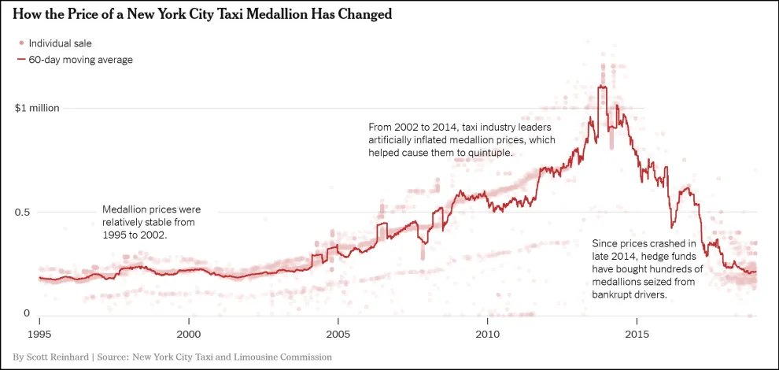
The Uber Effect
Notes:
Uber/Lyft are popular
Uber started in 2011 but number of trips outspaced yellow taxis for the first time in 2018
Taxis are not easily found. Riders wait longer when demand exceeds supply
13500 medallion cabs in NYC
They may not satisfy all the demand, but possible to improve their utilization

Slide 5
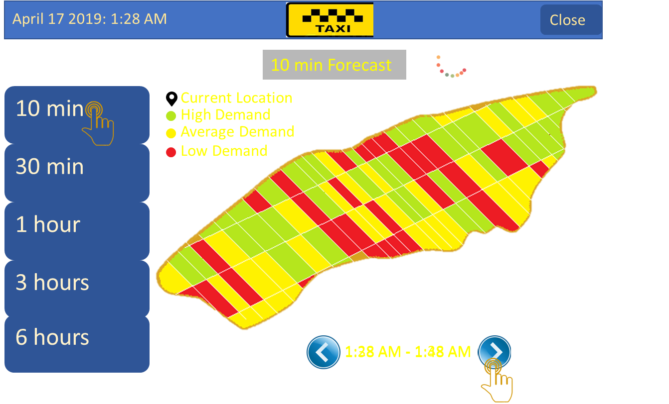
Application Future Scope

Slide 6
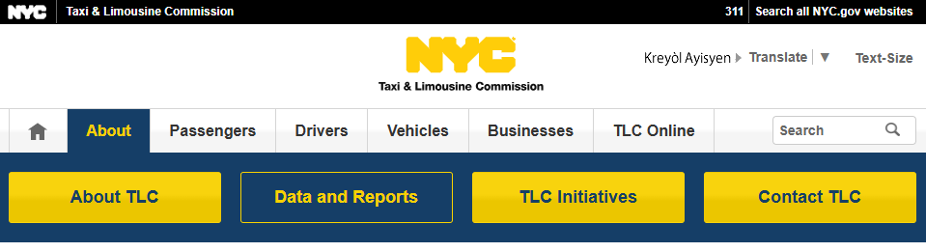
Dataset Exploration
TLC Trip Record Data
2009 - 2024
2024, January - August Dataset
22 Million Records, 1.8 Gb’s

Slide 7
Dataset Exploration
Dataset Provided By: Taxi and Limousine Commission (TLC)
Dataset Attributes:
VendorID
tpep_pickup_datetime
tpep_dropoff_datetime
passenger_count
trip_distance
RatecodeID
Store_and_fwd_flag
PULocationID
DOLocationID
payment_type
fare_amount
extra
mta_tax
tip_amount
tolls_amount
improvement_surcharge
total_amount
congestion_surcharge
airport_fee

Slide 8
Data Preprocessing
Handling Missing Values
Data Cleaning
Feature Engineering
Encoding Categorical Variables
Data Normalization/Scaling
Removing Duplicates
Filtering Data
Notes:
Handling Missing Values
Remove rows or columns with excessive missing data.
Impute missing values based on logical rules or domain knowledge (e.g., median trip distance or mode passenger count).
Data Cleaning
Remove Outliers:
Unreasonable values in trip_distance (e.g., negative or excessively high distances).
Fare amounts that are zero or extremely high.
Data Type Conversion:
Convert pickup_datetime and dropoff_datetime to datetime type.
Ensure numerical columns are in proper numeric formats.
Feature Engineering
Time-Based Features:
Extract features like day of the week, hour, holiday indicators, etc., from the datetime columns.
Geospatial Features:
Calculate distances (e.g., Haversine distance between pickup and drop-off coordinates).
Trip Duration:
Calculate trip duration from pickup_datetime and dropoff_datetime.
Encoding Categorical Variables
If the dataset includes categorical columns (e.g., payment_type), use encoding methods like one-hot encoding or label encoding.
Data Normalization/Scaling
Normalize or standardize numerical features like trip_distance, fare_amount, or calculated distances if required by your model.
Removing Duplicates
Identify and remove duplicate rows using .drop_duplicates().
Filtering Data
Remove trips with zero passengers.
Exclude trips with unrealistic or suspicious data (e.g., zero distance, same pickup and drop-off points).

Slide 9
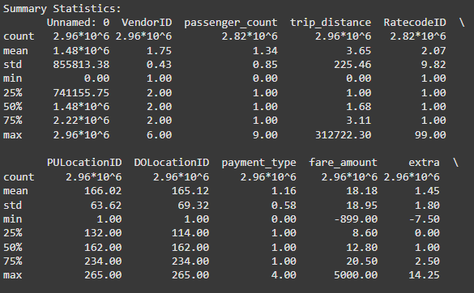
Exploratory Data Analysis
Notes:
Row Counts: Most columns have ~2.96 million entries, but some have slightly fewer (e.g., passenger_count and RatecodeID).
Passenger and Distance:
Average passenger_count is 1.34 (min: 0, max: 9).
trip_distance mean is 3.65, with a wide range (min: 0, max: ~312k), indicating outliers.
Fare and Amounts:
fare_amount averages $18.18 but ranges from -$899 to $5000, suggesting data errors.
total_amount also has negatives and extremes.
Location IDs:
PULocationID and DOLocationID cover valid ranges (1–265).

Slide 10
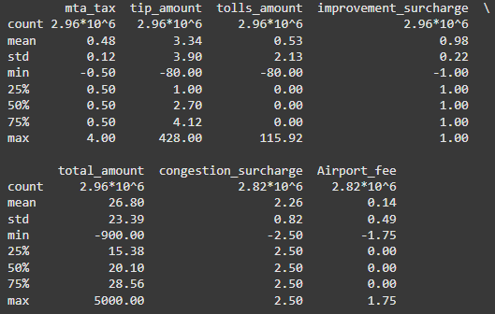
Exploratory Data Analysis
Notes:
Other Columns:
Issues in extra, tip_amount, and tolls_amount (e.g., negatives and unusually high values).
payment_type and RatecodeID show standard categorizations but might need verification for consistency.
Surcharges and Fees:
congestion_surcharge and Airport_fee mostly follow predictable patterns, though negatives exist.

Slide 11
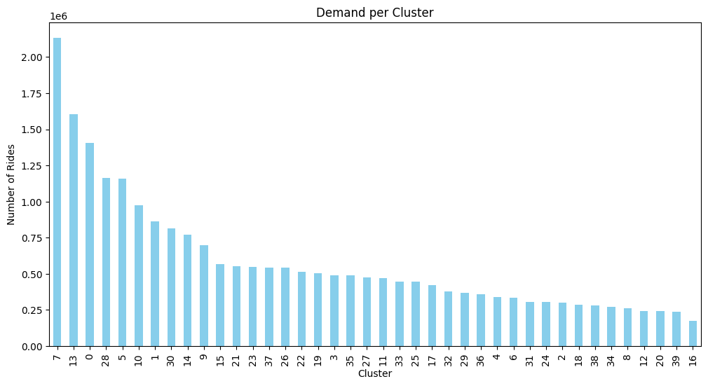
Exploratory Data Analysis

Slide 12
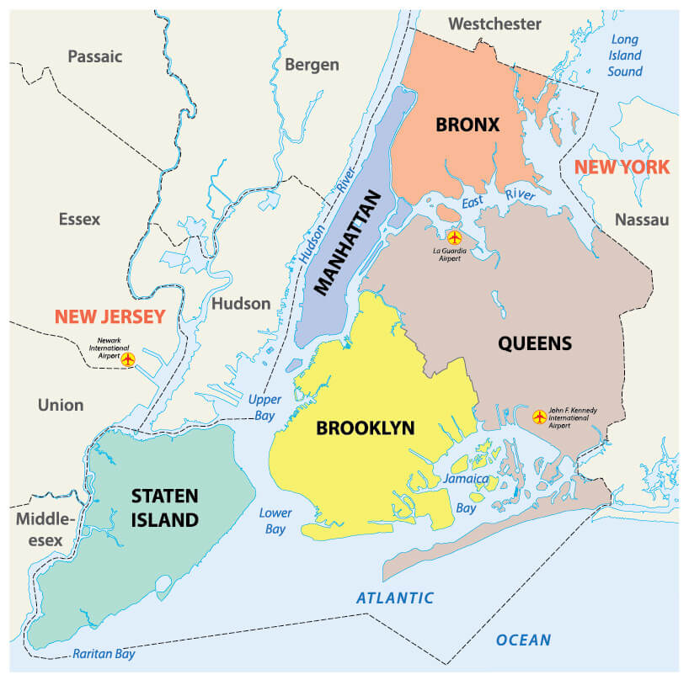
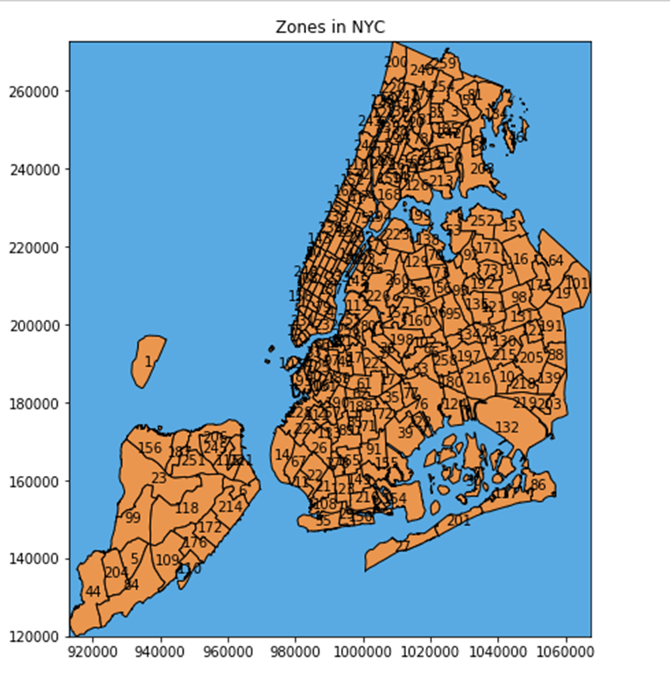
Exploratory Data Analysis

Slide 13
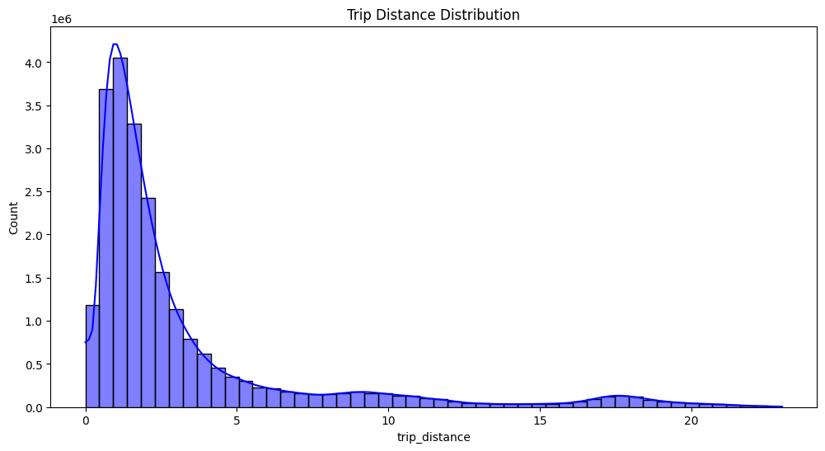
Exploratory Data Analysis

Slide 14
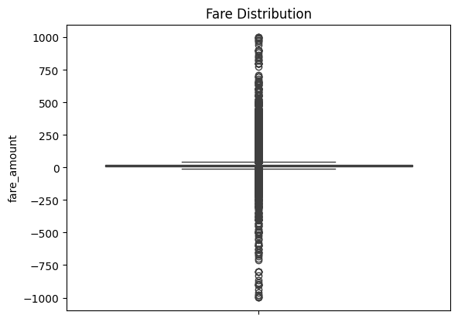
Exploratory Data Analysis

Slide 15
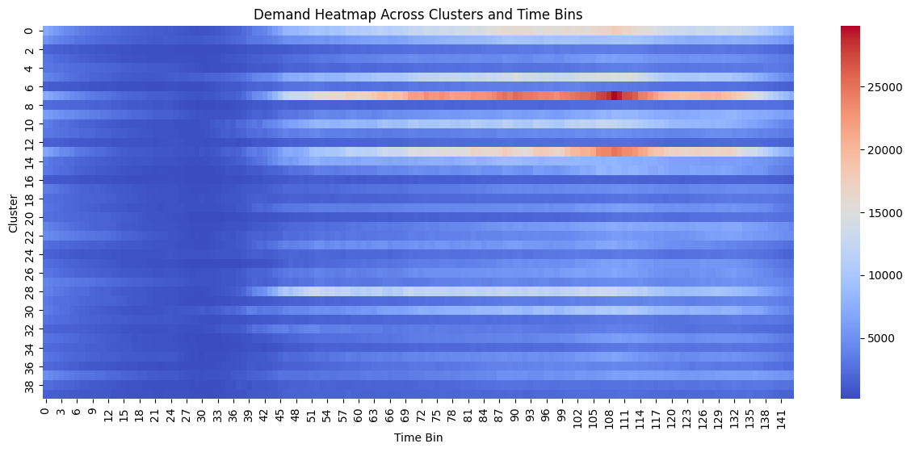
Exploratory Data Analysis

Slide 16
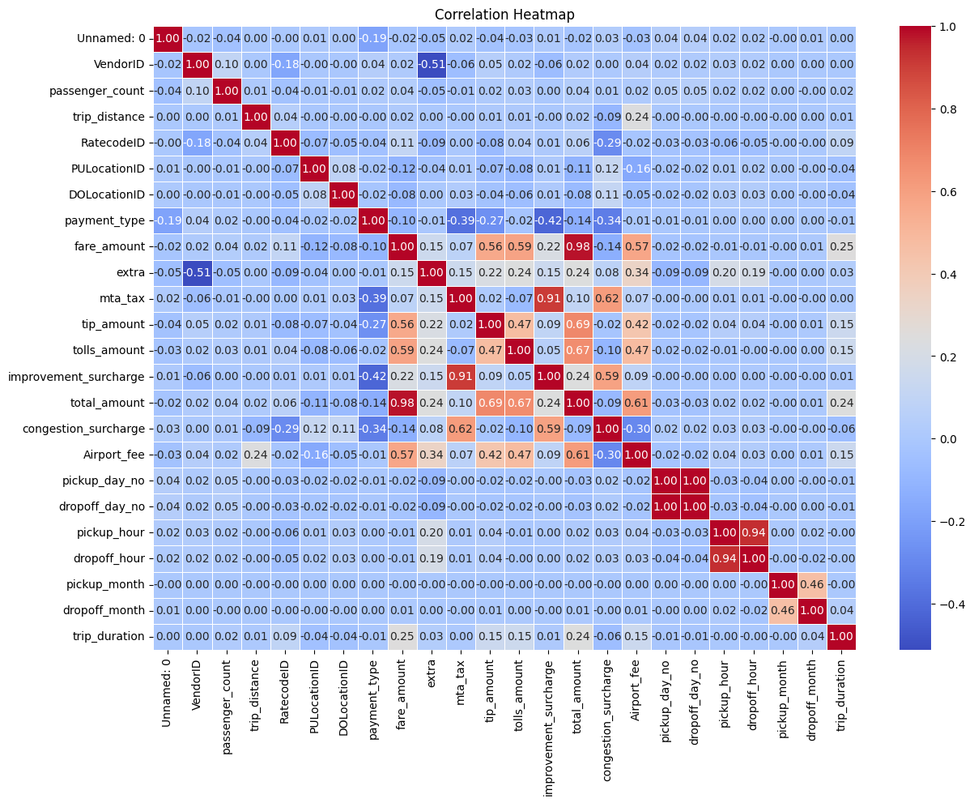
Exploratory Data Analysis

Slide 17
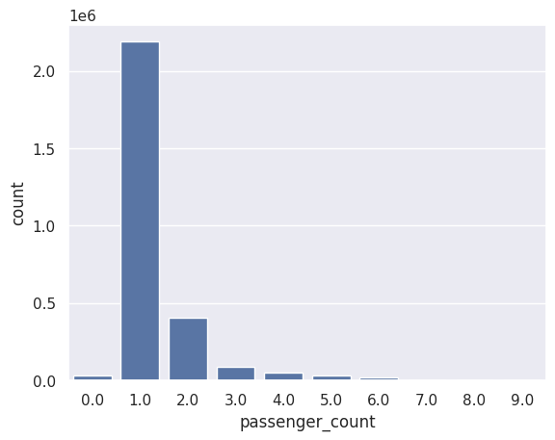
Exploratory Data Analysis

Slide 18
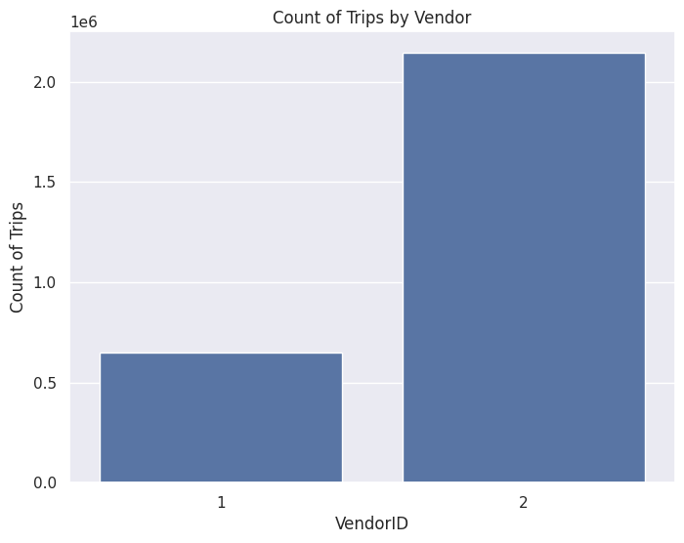
Exploratory Data Analysis
1 = Creative Mobile Technologies, LLC
2 = VeriFone Inc.

Slide 19
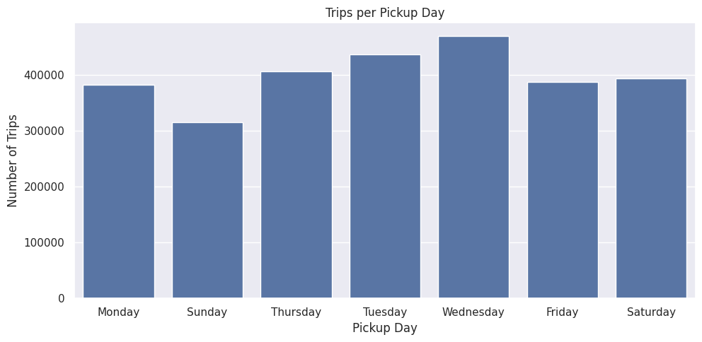
Exploratory Data Analysis

Slide 20
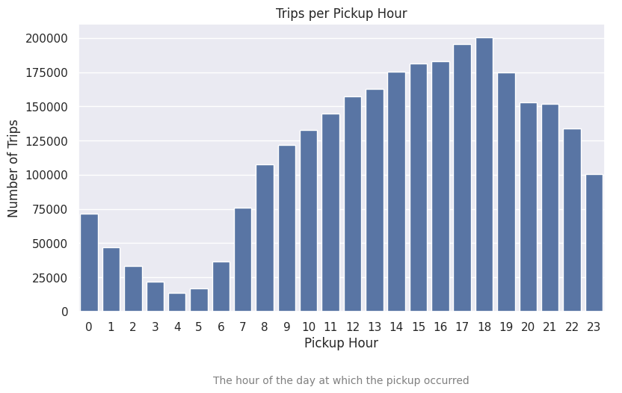
Exploratory Data Analysis

Slide 21
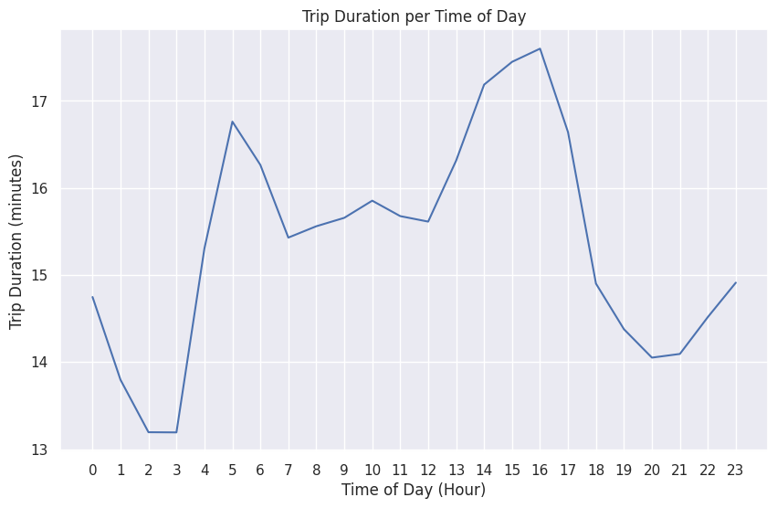
Exploratory Data Analysis

Slide 22
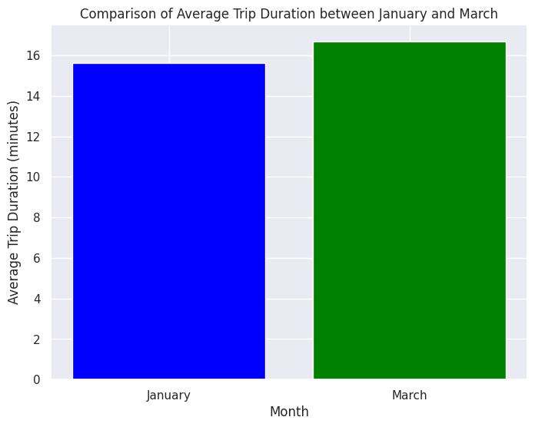
Exploratory Data Analysis

Slide 23
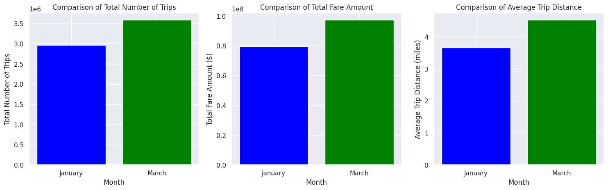
Exploratory Data Analysis

Slide 24
Feature Engineering
Datetime Conversion
Trip Duration
Speed Calculation
Clustering
Time Binning
Time-Series Demand Preparation
Sequence Creation for LSTM
Normalization
Notes:
Trip Duration
trip_duration_hours=(tpep_dropoff_datetime−tpep_pickup_datetime​)/3600
Speed Calculation
Computes the average speed for each trip: average_speed_mph=tripdistance/trip_duration_hours
Filters trips with unrealistic speeds (average_speed_mph > 45.31).

Slide 25
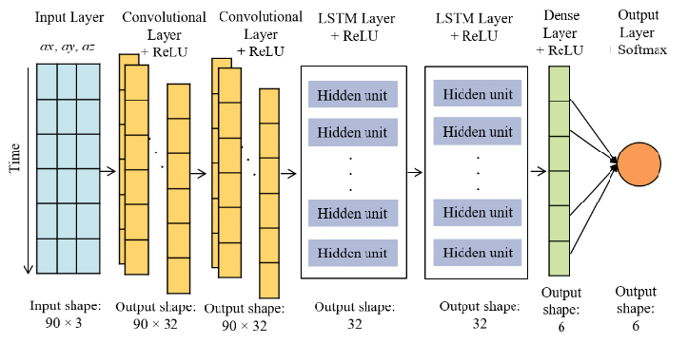
CNN - LSTM Model Architecture
Notes:
Trip Duration
trip_duration_hours=(tpep_dropoff_datetime−tpep_pickup_datetime​)/3600
Speed Calculation
Computes the average speed for each trip: average_speed_mph=tripdistance/trip_duration_hours
Filters trips with unrealistic speeds (average_speed_mph > 45.31).

Slide 26
CNN - LSTM Model Architecture
Input Layer: Time-series data organized as sequences where sequence length is the number of past time steps (eg : 10 time bins); and variables for each time step, such as spatial clusters, environmental data, or demand metrics
CNN Layers: CNN extracts spatial or temporal patterns from input data and identifies short term relationship/trends. The Convolutional layer applies filters to detect patterns in the data. Outputs the compressed feature maps containing learned patterns from the raw input data.
Notes:
Trip Duration
trip_duration_hours=(tpep_dropoff_datetime−tpep_pickup_datetime​)/3600
Speed Calculation
Computes the average speed for each trip: average_speed_mph=tripdistance/trip_duration_hours
Filters trips with unrealistic speeds (average_speed_mph > 45.31).

Slide 27
CNN - LSTM Model Architecture
3. LSTM Layers: Models long-term temporal dependencies and sequential patterns from the extracted features and Handles time-series data effectively by retaining memory of previous states.
The Bidirectional LSTM Combines information from both forward and backward directions for richer context and Stacked LSTMs are multiple layers for hierarchical learning of temporal features
Notes:
Trip Duration
trip_duration_hours=(tpep_dropoff_datetime−tpep_pickup_datetime​)/3600
Speed Calculation
Computes the average speed for each trip: average_speed_mph=tripdistance/trip_duration_hours
Filters trips with unrealistic speeds (average_speed_mph > 45.31).

Slide 28
CNN - LSTM Model Architecture
4. Dense Layer: Transforms the output from LSTM layers into the desired output format and Matches the number of output neurons to the forecasting target (e.g., predicted demand for all clusters in the next time bin).
The Activation Function is typically linear for regression tasks (eg: forecasting)
5. Output Layer: Outputs the forecasted values for the next time step(s), such as taxi demand for each spatial cluster.
Notes:
Trip Duration
trip_duration_hours=(tpep_dropoff_datetime−tpep_pickup_datetime​)/3600
Speed Calculation
Computes the average speed for each trip: average_speed_mph=tripdistance/trip_duration_hours
Filters trips with unrealistic speeds (average_speed_mph > 45.31).

Slide 29
Model Training and Evaluation
Training Process
Data Preparation: Time-series data is converted into sliding windows of squence_length for input (X_train) and target (y_train). Data is normalized (e.g., Min-Max Scaling) to improve model convergence.
Optimizers: Adam Optimizer is used for adaptive learning, providing faster convergence and handling sparse gradients efficiently. Learning rate set to a small value (e.g., 0.0005) for stable training
Loss Function: MSE is employed to minimize the difference between predicted and actual values, focusing on regression accuracy.
Notes:
Trip Duration
trip_duration_hours=(tpep_dropoff_datetime−tpep_pickup_datetime​)/3600
Speed Calculation
Computes the average speed for each trip: average_speed_mph=tripdistance/trip_duration_hours
Filters trips with unrealistic speeds (average_speed_mph > 45.31).

Slide 30
Model Training and Evaluation
4. Callbacks: Early stopping monitors validation loss and halts training when it stops improving, avoiding overfitting. ReduceLROnPlateau adjusts the learning rate dynamically when validation loss stagnates, enabling finer updates.
5. Batch Size: A mini-batch size of 64 is used to balance training speed and gradient computation accuracy.
6. Epochs: The model is trained for up to 200 epochs which stops early due to early stopping.
Notes:
Trip Duration
trip_duration_hours=(tpep_dropoff_datetime−tpep_pickup_datetime​)/3600
Speed Calculation
Computes the average speed for each trip: average_speed_mph=tripdistance/trip_duration_hours
Filters trips with unrealistic speeds (average_speed_mph > 45.31).

Slide 31
Model Training and Evaluation
Evaluation
Mean Absolute Error (MAE): Measures the average magnitude of prediction errors, providing an interpretable measure of accuracy.
Mean Squared Error (MSE): Penalizes larger errors more heavily, ensuring the model focuses on reducing significant deviations.
Root Mean Squared Error (RMSE): Provides an error value in the same units as the target variable for better interpretability
R-squared (R²): Indicates the proportion of variance in the target variable explained by the model
Notes:
Trip Duration
trip_duration_hours=(tpep_dropoff_datetime−tpep_pickup_datetime​)/3600
Speed Calculation
Computes the average speed for each trip: average_speed_mph=tripdistance/trip_duration_hours
Filters trips with unrealistic speeds (average_speed_mph > 45.31).

Slide 32
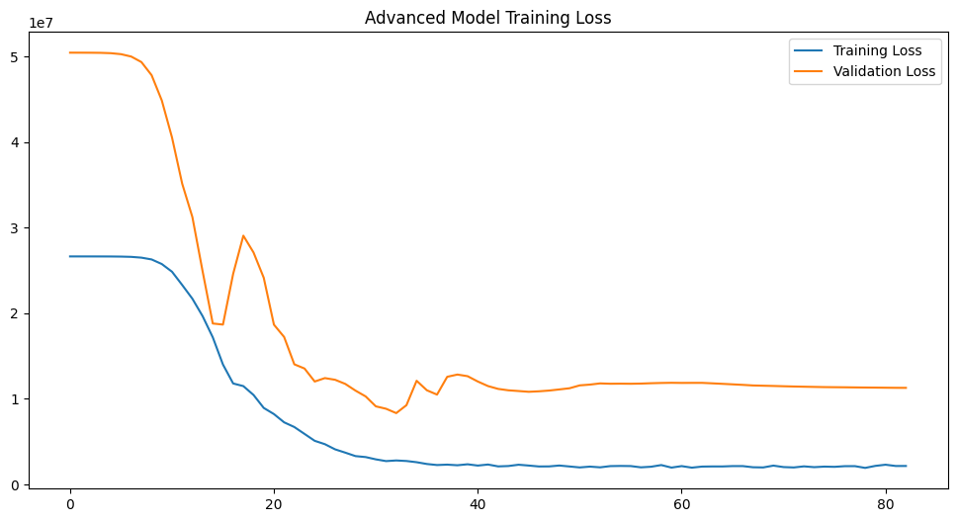
Model Training and Evaluation
RMSE: 2886.57
MAPE: 38.56%
Notes:
Trip Duration
trip_duration_hours=(tpep_dropoff_datetime−tpep_pickup_datetime​)/3600
Speed Calculation
Computes the average speed for each trip: average_speed_mph=tripdistance/trip_duration_hours
Filters trips with unrealistic speeds (average_speed_mph > 45.31).

Slide 33
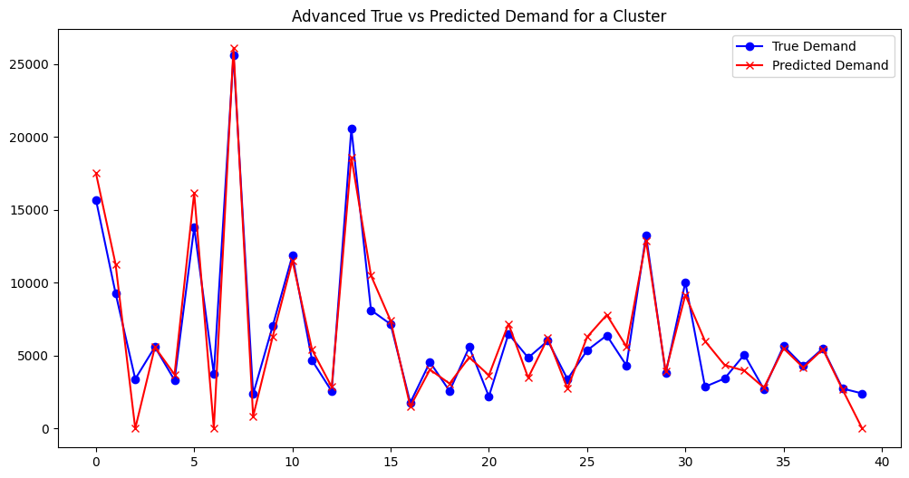
Model Training and Evaluation
Notes:
Trip Duration
trip_duration_hours=(tpep_dropoff_datetime−tpep_pickup_datetime​)/3600
Speed Calculation
Computes the average speed for each trip: average_speed_mph=tripdistance/trip_duration_hours
Filters trips with unrealistic speeds (average_speed_mph > 45.31).

Slide 34


Conclusion
Notes:
Trip Duration
trip_duration_hours=(tpep_dropoff_datetime−tpep_pickup_datetime​)/3600
Speed Calculation
Computes the average speed for each trip: average_speed_mph=tripdistance/trip_duration_hours
Filters trips with unrealistic speeds (average_speed_mph > 45.31).

Slide 35

THANK
YOU
Notes:
Trip Duration
trip_duration_hours=(tpep_dropoff_datetime−tpep_pickup_datetime​)/3600
Speed Calculation
Computes the average speed for each trip: average_speed_mph=tripdistance/trip_duration_hours
Filters trips with unrealistic speeds (average_speed_mph > 45.31).

